Slide 1

NaCl vs. Emscripten
Aaron Dodson
Geoffrey Douglas
CS263: Programming Languages

Slide 2
Review of Emscripten
Cross-compiler from LLVM bitcode to Javascript
Includes Javascript implementation of standard library, filesystem, and runtime support

Slide 3
Review of NaCl
Run native compiled code on the web
Portability
Security
Modules and Instances
Communication

Slide 4
PNGCrush
Open source command-line .png image optimizer
Reduces the size of .png images based on multiple compression methods
27 source files, 30,000+ lines of code

Slide 5
Web App Wrapper
HTML5 Drag and Drop for file upload
NaCl uses HTML5 filesystem API for file I/O
Built on Twitter Bootstrap
Blobs

Slide 6
Porting PNGCrush with Emscripten
Source files compiled to LLVM bitcode
LLVM bitcode compiled to Javascript
Reading/Writing files
Cross-compiled code function calling
Communication

Slide 7
Porting PNGCrush with
NaCl
hello_nacl_io
Modifying the makefile
Filesystem API
Call to PNGCrush main
Communication
  Asynchronous

Slide 8
Demo

Slide 9
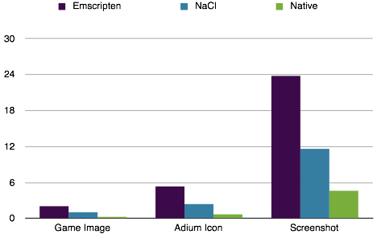
Comparisons

Slide 10
Implementation Difficulties
Poor documentation
PNGCrush codebase
Communication in Emscripten port

Slide 11
Conclusions
Better performance for NaCl
Good for porting legacy codebases
Easy web app creation

Slide 12
Questions?

